Slide 1

Fundamentals of Electric Circuits 2020.3
Chapter 4
Circuit Theorems

Slide 2
Chapter 4 Circuit Theorems
4.1 Motivation
4.2 Linearity Property
4.3 Superposition
4.4 Source Transformation
4.5 Substitution theorem
4.6 Simplification of a one-port network
4.7 Thevenin’s Theorem
4.8 Norton’s Theorem
4.9 Maximum Power Transfer

Slide 3
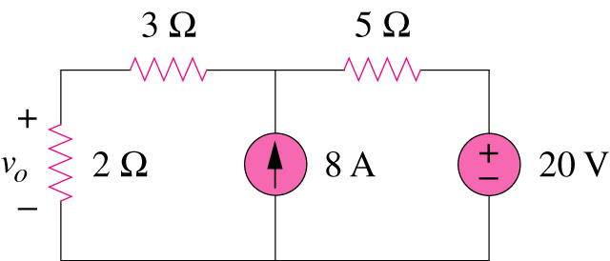
If you are required to determine the voltage across 2Ω resistor, we can first replace the two resistors with only one resistor to simplify the circuit.
4.1 Motivation
Are there any other method to simplify circuit analysis ?
What are they? And how?
Can you work it out by inspection?

Slide 4
4.1 Motivation
Some theorems are developed to simplify circuit analysis. Such theorems include Thevenin’s theorems and Norton’s theorems.
Since these theorems are applicable to linear circuits, we first discuss the concept of circuit linearity.
In addition to circuit theorems, we discuss the concepts of superposition, source transformation, and maximum power transfer in this chapter.

Slide 5
4.2 Linearity Property
linear circuit
Linear element: Linear relationship
A linear circuit: one circuit whose output is linearly related (or directly proportional) to its input.
Linearity is a combination of both the homogeneity (scaling) property and the additivity property.

Slide 6
4.2 Linearity Property
The homogeneity property: if the input (also called the excitation) is multiplied by a constant, then the output (also called the response) is multiplied by the same constant.
For a resistor, for example, Ohm’s law relates the input i to the output v .
v = iR
If the current is increased by a constant k, then the voltage increases correspondingly by k, that is,
Homogeneity (scaling) property
v = i R → k v = k i R

Slide 7
4.2 Linearity Property
The additivity property: the response to a sum of inputs is the sum of the responses to each input applied separately.
Using the voltage-current relationship of a resistor, if
v₁ = i₁R
v₂ = i₂R
then applying (i₁ + i₂) gives
Additive property
→ v = (i₁ + i₂) R = i₁R + i₂R = v₁ + v₂

Slide 8
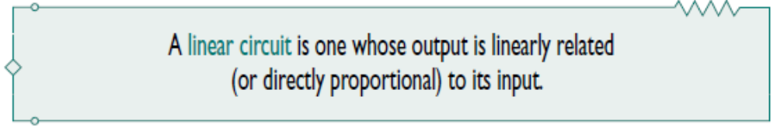
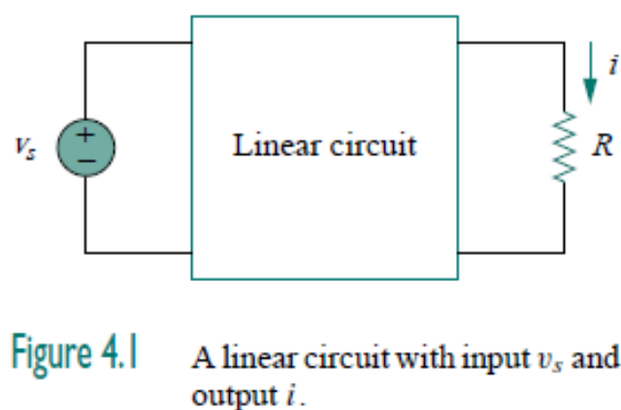
Consider the linear circuit shown in Fig. 4.1.
Suppose v_{s} = 10 V gives i = 2 A. According to the linearity principle, v_{s} = 20 V will give i = 4 A.

Slide 9
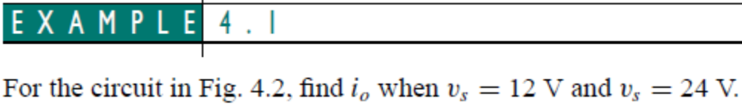
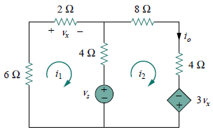
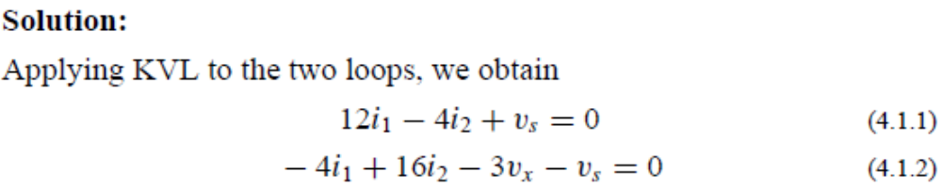





Controlling equation

Slide 10
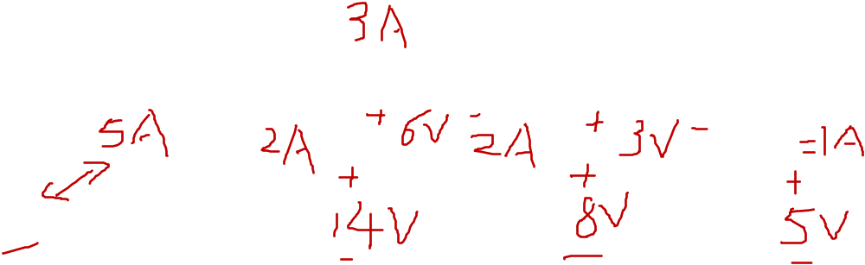
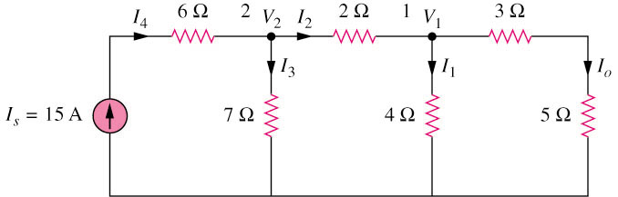
4.2 Linearity Property (2)
Example 4.2
Use linearity to find the actual value of I_{o} in the circuit shown below.
By assume I_{o} = 1 A,
Answer I_{o} = 3A

Slide 11
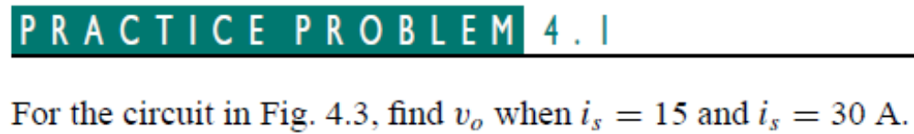
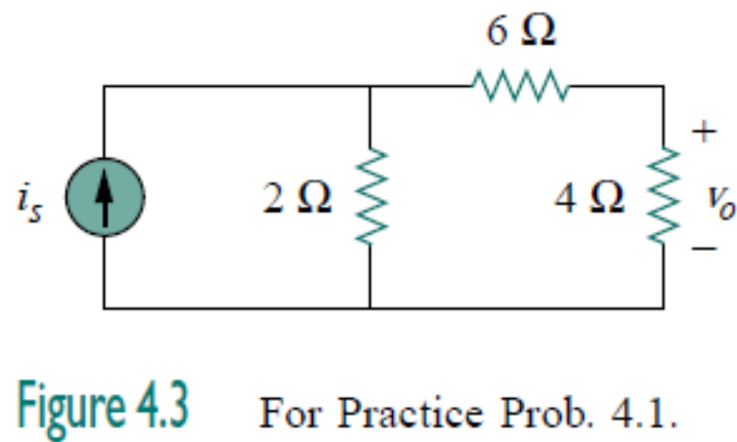


Slide 12
Summary of last class
A linear circuit: one circuit whose output is linearly related (or directly proportional) to its input.
Linearity is a combination of both the homogeneity (scaling) property and the additivity property.
The homogeneity property: if the input (also called the excitation) is multiplied by a constant, then the output (also called the response) is multiplied by the same constant.
The additivity property: the response to a sum of inputs is the sum of the responses to each input applied separately.

Slide 13
4.3 Superposition Theorem
If a circuit has two or more independent sources:
Method 1: Nodal or mesh analysis method.
Method 2: Superposition.
Superposition: If a linear circuit with more than one independent source, its response is the algebraic sum of the contribution of each independent source acting alone.

Slide 14
4.3 Superposition Theorem
One independent source acting alone, means all other independent sources are turned off. This implies that we replace
  every voltage source by 0 V (or a short circuit),
  every current source by 0 A (or an open circuit).
A voltage source set to zero acts like a short circuit
A current source set to zero acts like an open circuit
i
0A
0V
i
u
u
“turned off” or “zeroed out”,
“turned off” or “zeroed out”,
2. Dependent sources are left.

Slide 15
4.3 Superposition Theorem (3)
Steps to apply superposition principle
Let one independent source acting alone, and find the output (voltage or current) due to that active source using nodal or mesh analysis.
Repeat step 1 for each of the other independent sources.
Find the total contribution by adding algebraically all the contributions.
Pay attention to the reference direction.

Slide 16
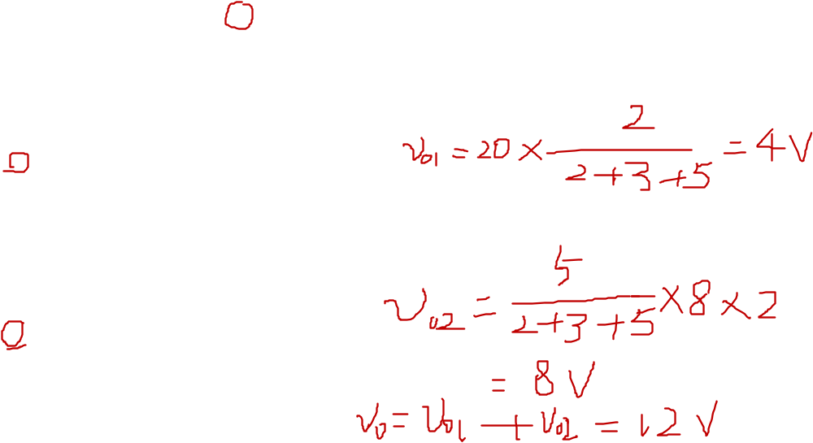
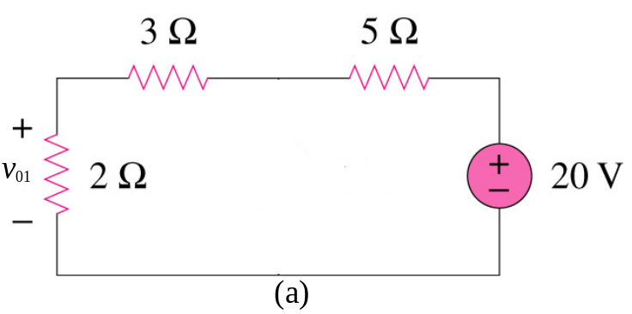
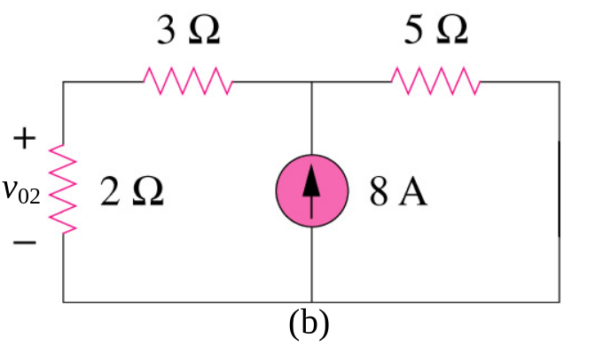
4.3 Superposition Theorem
We consider the effects of 8A and 20V one by one, then add the two effects together for final v_{o}.

Slide 17
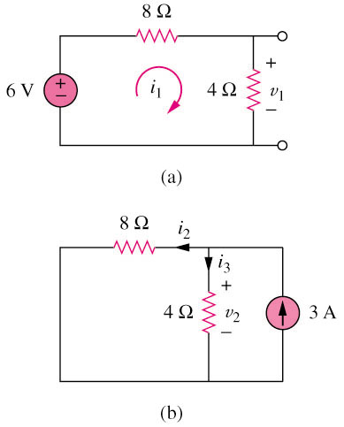
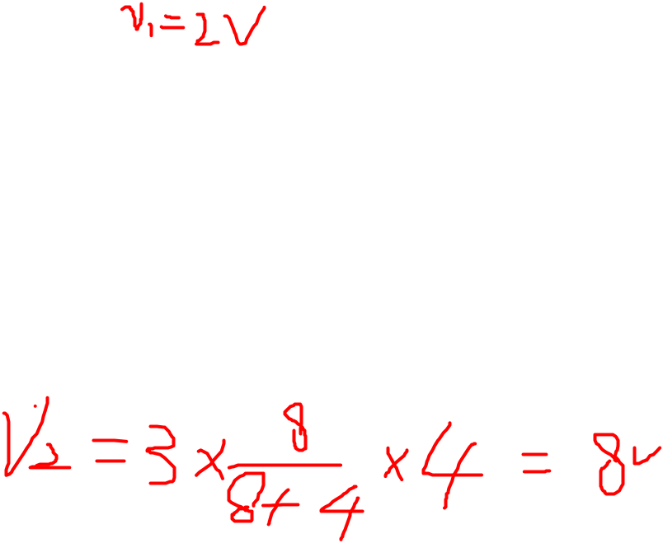
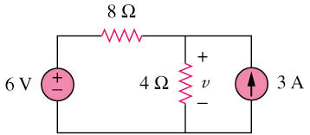
4.3 Superposition Theorem (5)
Example 2 Use the superposition theorem to find v in the circuit shown below.
3A is discarded by open-circuit
6V is discarded by short-circuit
Answer v = 10V

Slide 18
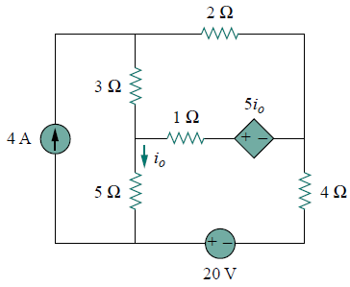
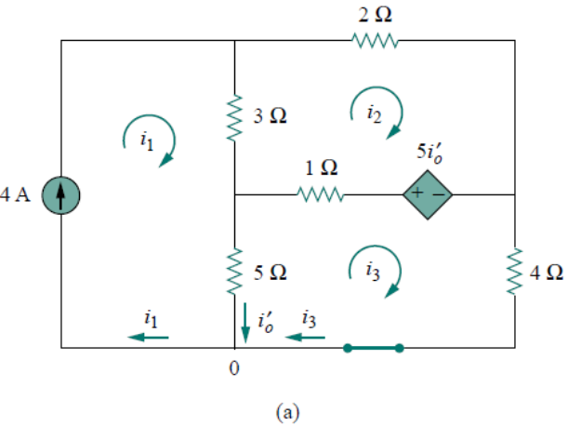
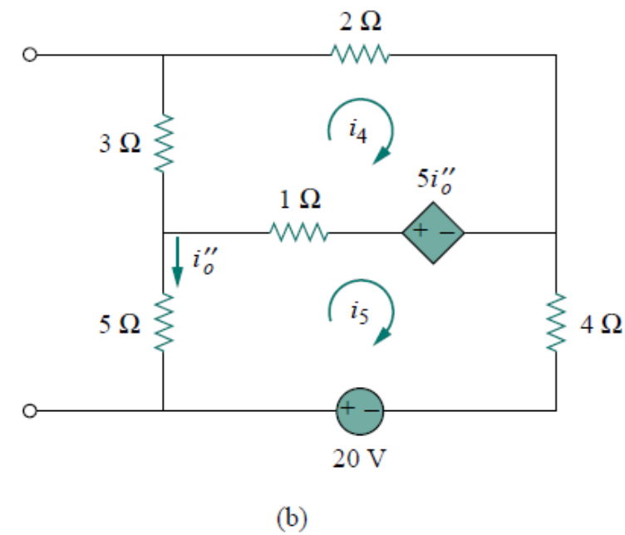
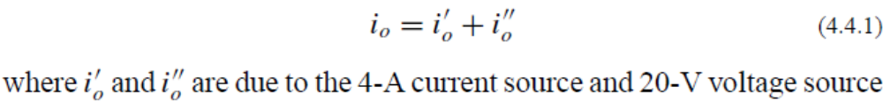
Example 4 Use superposition to find i₀ in the circuit below.
The circuit involves a dependent source, which must be left intact. We let.

Slide 19
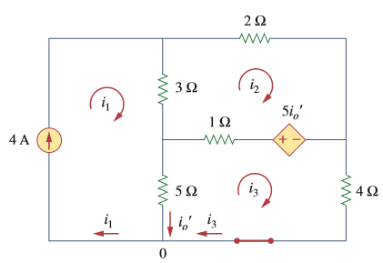

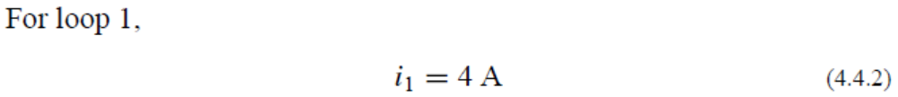
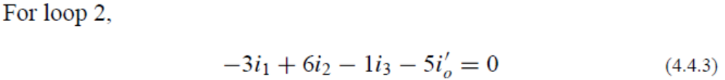

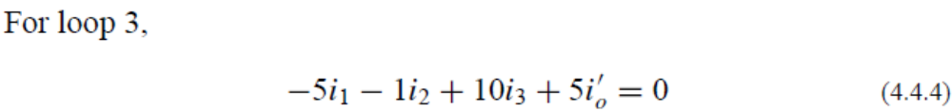
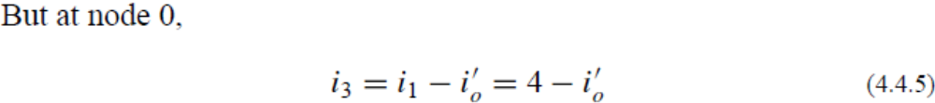
To obtain i_{o}’, we turn off the 20-V source so that we have the circuit in Fig. 4.10(a). We apply mesh analysis in order to obtain i_{o}’.

Slide 20
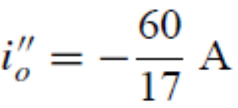
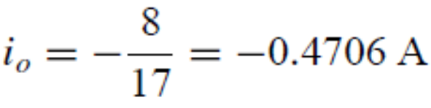
To obtain i_{o}’’, we turn off the 4-A current source so that we have the circuit in Fig. 4.10(b). We apply mesh analysis in order to obtain i_{o}’’.
For loop 4, KVL gives
For loop 5, KVL gives

Slide 21
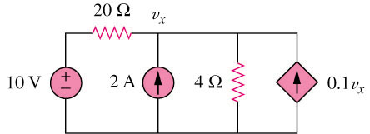
Example 6
Use superposition to find v_{x} in the circuit below.
2A is discarded by open-circuit
10V is discarded by short-circuit
Dependant source keep unchanged
20 Ω
v₁
20 Ω
v₂
+
−
10 V
4 Ω
0.1v₁
2 A
4 Ω
0.1v₂
(a)
(b)
Answer Vx = 12.5V

Slide 22
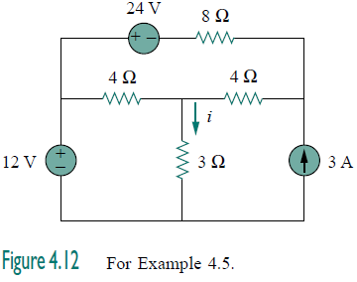
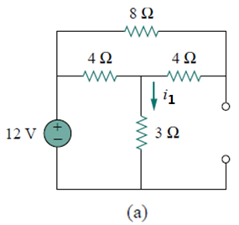
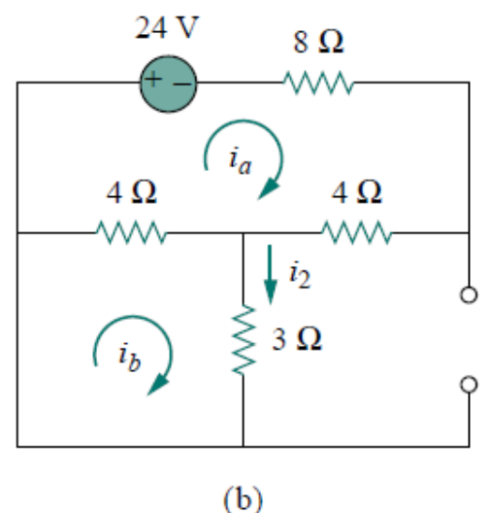
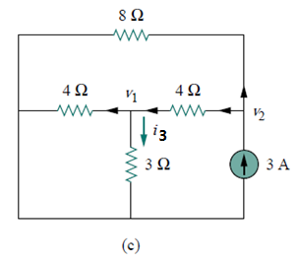

Slide 23
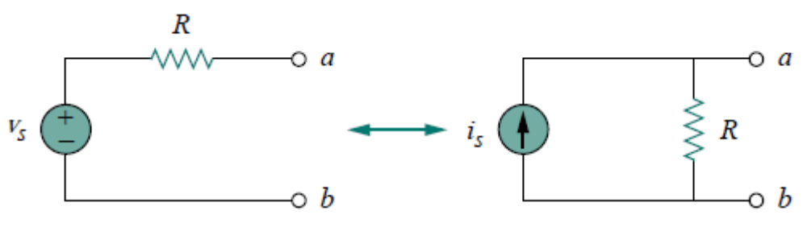
4.4 Source Transformation
Source transformation is another tool for simplifying circuits.
It is the process of replacing a voltage source v_{S} in series with a resistor R by a current source i_{S} in parallel with a resistor R, or vice versa.

Slide 24
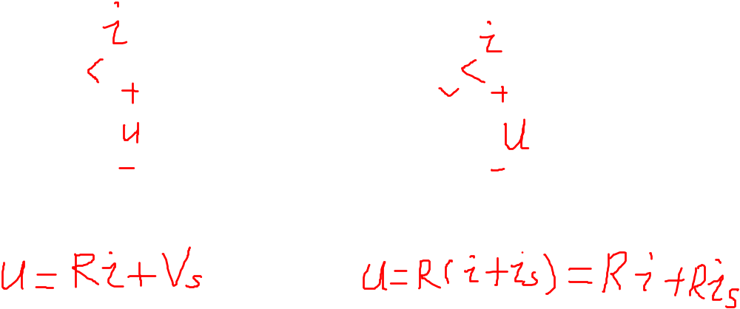


4.4 Source Transformation (1)
(a) (b)
For (a): (b)
Steps to replace (a) by (b):
Structure:
before : a voltage source v_{S} in series with a resistor R
Now: a current source i_{S} in parallel with a resistor R
2. Value: R the same,
3. Source direction:
the ‘-’ to ‘+’ direction of voltage source= current source direction.

Slide 25
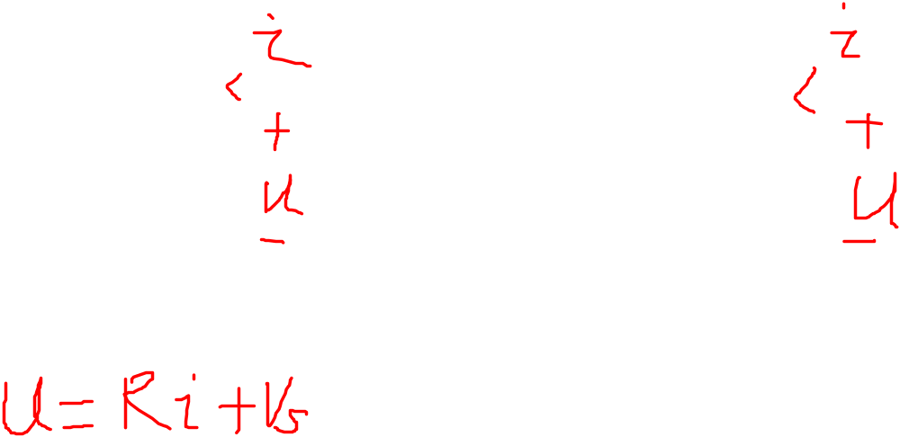



4.4 Source Transformation (1)
(a) (b)
Steps to replace (b) by (a):
Structure:
before : a current source i_{S} in parallel with a resistor R
Now: a voltage source v_{S} in series with a resistor R
2. Value: R the same,
3. Source direction:
current source direction= the ‘-’ to ‘+’ direction of voltage source.

Slide 26
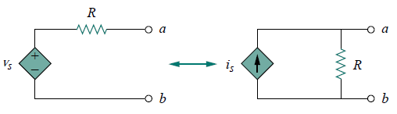
4.4 Source Transformation (1)

Slide 27
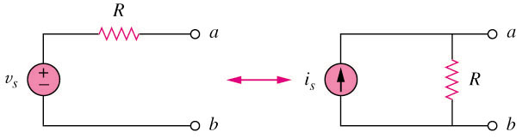
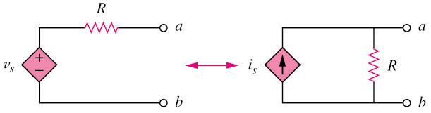
4.4 Source Transformation (2)
+
+
The arrow of the current source is directed toward the positive terminal of the voltage source.
The source transformation is not possible when R = 0 for voltage source and R = ∞ for current source.
-
-
(a) Independent source transform
+
+
-
-
(b) Dependent source transform

Slide 28
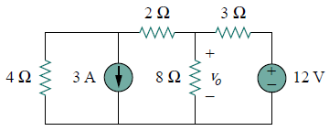
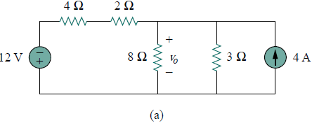
Example 4.6
Find v_{o} in the circuit shown below using source transformation.
We first transform the current and voltage sources to obtain the circuit in Fig. 4.18(a).

Slide 29
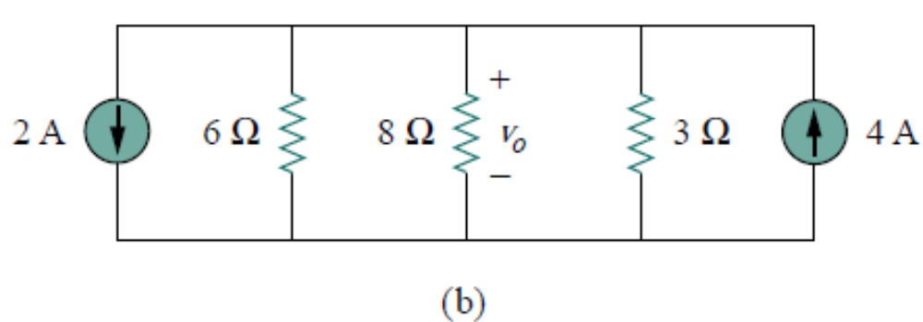
Combining the 4-Ω and 2- Ω resistors in series and transforming
the 12-V voltage source gives us Fig. 4.18(b).

Slide 30
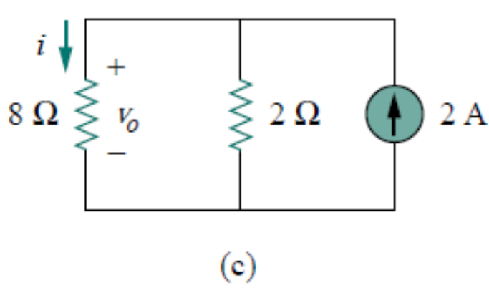
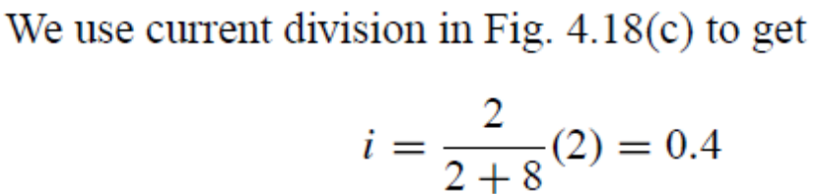


Slide 31
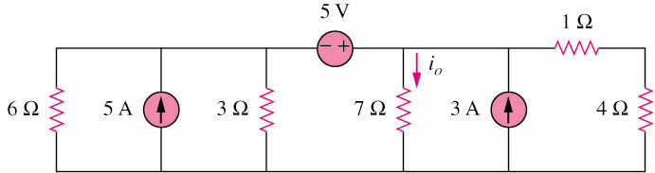
Practice 4
Find i_{o} in the circuit shown below using source transformation.
i₀ = 1.78A

Slide 32
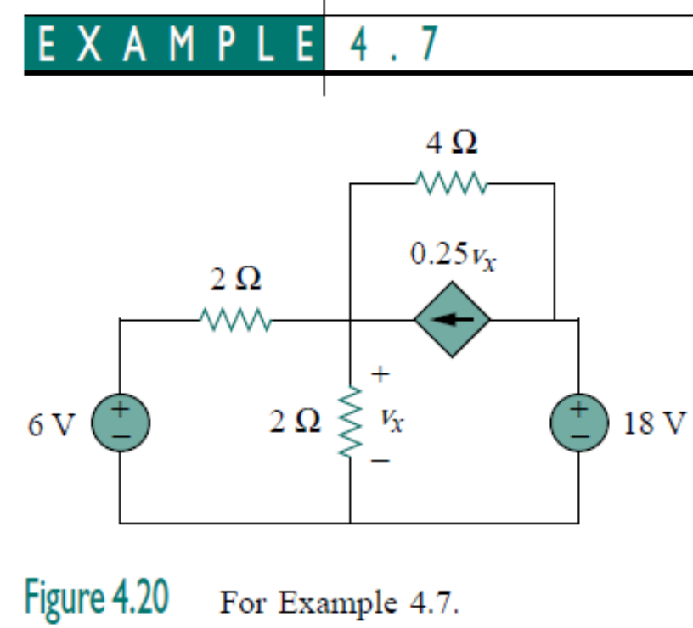
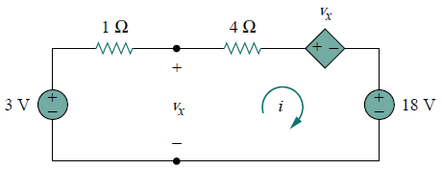
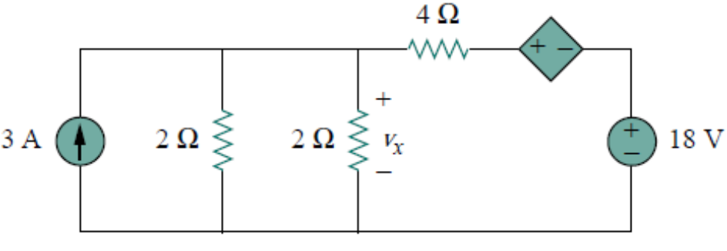




Slide 33
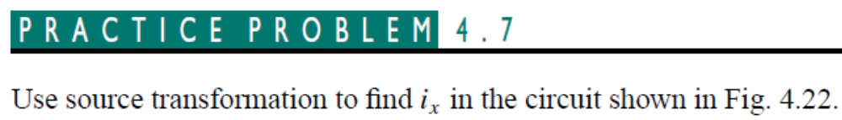
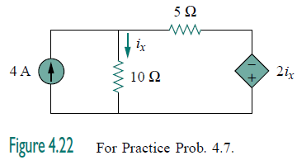


Slide 34
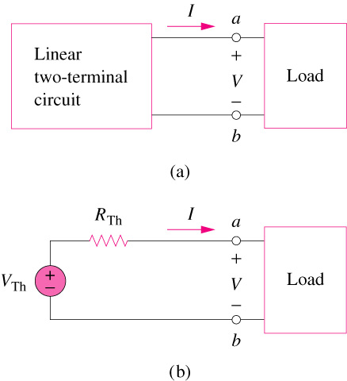
4.6 Thevenin’s Theorem (1)
It states that a linear two-terminal circuit (Fig. a) can be replaced by an equivalent circuit (Fig. b) consisting of a voltage source V_{TH} in series with a resistor R_{TH},
where
V_{TH} is the open-circuit voltage at the terminals.
R_{TH} is the input or equivalent resistance at the terminals when the independent sources are turned off.

Slide 35



4.6 Thevenin’s Theorem (1)

Slide 36




4.6 Thevenin’s Theorem (1)
V_{Th} is the open-circuit voltage across the terminals
R_{Th} is the input resistance at the terminals when the independent sources are turned off.

Slide 37





Slide 38


4.6 Thevenin’s Theorem (1)
To apply this idea in finding the Thevenin resistance R_{Th}, we need to consider two cases.

Slide 39





Slide 40


Find R_{TH:}

Slide 41









Slide 42



4.6 Thevenin’s Theorem (1)
To apply this idea in finding the Thevenin resistance R_{Th}, we need to consider two cases.

Slide 43



Slide 44







Slide 45

Example 6
Find the Thevenin equivalent circuit of the circuit shown below to the left of the terminals.
5 Ω
I_{x}
3 Ω
a
+
−
+
V_{Th}
−
i₂
6 V
i₁
4 Ω
1.5I_{x}
i₁
i₂
o
b
(a)
0.5I_{x}
3 Ω
I_{x}
i
a
+
−
5 Ω
1.5I_{x}
4 Ω
1 V
(b)
b
V_{TH} = 5.33V, R_{TH} = 3Ω

Slide 46

4.8 Norton’s Theorem
It states that a linear two-terminal circuit can be replaced by an equivalent circuit of a current source I_{N} in parallel with a resistor R_{N},
Where
I_{N} is the short circuit current through
the terminals.
R_{N} is the input or equivalent resistance
at the terminals when the independent
sources are turned off.

Slide 47





4.8 Norton’s Theorem

Slide 48



4.8 Norton’s Theorem
The Thevenin’s and Norton equivalent circuits are related by a source transformation.

Slide 49
4.8 Norton’s Theorem

Slide 50


4.8 Norton’s Theorem

Slide 51






Slide 52






Slide 53









Slide 54


Find the Norton equivalent circuit for the circuit in Fig. 4.42, at
terminals a-b.

Slide 55





Find the Norton equivalent circuit for the circuit in Fig. 4.43, at
terminals a-b.

Slide 56

Example 7
Find the Norton equivalent circuit of the circuit shown below.
2v_{x}
+ −
i
+
v_{x}
−
+
−
6 Ω
i_{x}
2 Ω
1V
(a)
2v_{x}
+ −
+
v_{x}
−
6 Ω
10 A
2 Ω
I_{sc}
(b)
R_{N} = 1Ω, I_{N} = 10A.

Slide 57

4.9 Maximum Power Transfer

Slide 58





4.9 Maximum Power Transfer
If the entire circuit is replaced by its Thevenin equivalent except for the load, the power delivered to the load is:

Slide 59


4.9 Maximum Power Transfer
For maximum power dissipated in R_{L}, P_{max}, for a given R_{TH},
and V_{TH},
The power transfer profile with different R_{L}

Slide 60


4.9 Maximum Power Transfer

Slide 61




Slide 62











Slide 63

Example 8
Determine the value of R_{L} that will draw the maximum power from
the rest of the circuit shown below. Calculate the maximum power.
v_{x}
4 Ω
v_{x}
4 Ω
+ −
v₀
+ −
Fig. a
=> To determine R_{TH}
Fig. b
=> To determine V_{TH}
2 Ω
i
2 Ω
1 Ω
+
−
+
−
1 Ω
+
V_{Th}
−
1 V
9 V
i_{o}
+
−
+
−
3v_{x}
3v_{x}
(a)
(b)
R_{L} = 4.22Ω, P_{m} = 2.901W

Slide 64
Summary and Review
The principle of superposition states that the response in a linear circuit can be obtained by adding the individual responses caused by the separate independent sources acting alone.
Superposition is most often used when it is necessary to determine the individual contribution of each source to a particular response.

Slide 65
Source transformations allow us to convert voltage source in series with a resistor into a practical current source in parallel with a resistor , and vice versa.
Repeated source transformations can greatly simplify analysis of a circuit by providing the means to combine resistors and source.

Slide 66
The Thévenin equivalent of a network is a resistor in series with an independent voltage source. The Norton equivalent is the same resistor in parallel with an independent current source.
There are several ways to obtain the Thévenin equivalent resistance, depending on whether or not dependent sources are present in the network.
Maximum power transfer occurs when the load resistor matches the Thévenin equivalent resistance of the network to which it is connected.

Slide 67
Assignment (page 162)
Problems 4.11, 4.15, 4.23, 4.31, 4.41,
4.47, 4.57, 4.66, 4.71,

